Slide 1
dsh cli
date: 2026-10-23
contact: wilbert schelvis / unibox@kpn.com

Slide 2
what is the cli (refresher)?
command line interface on top of the dsh rest api
allows management of resources on the dsh platform
targeted at development, operations and ci/cd use cases

Slide 3
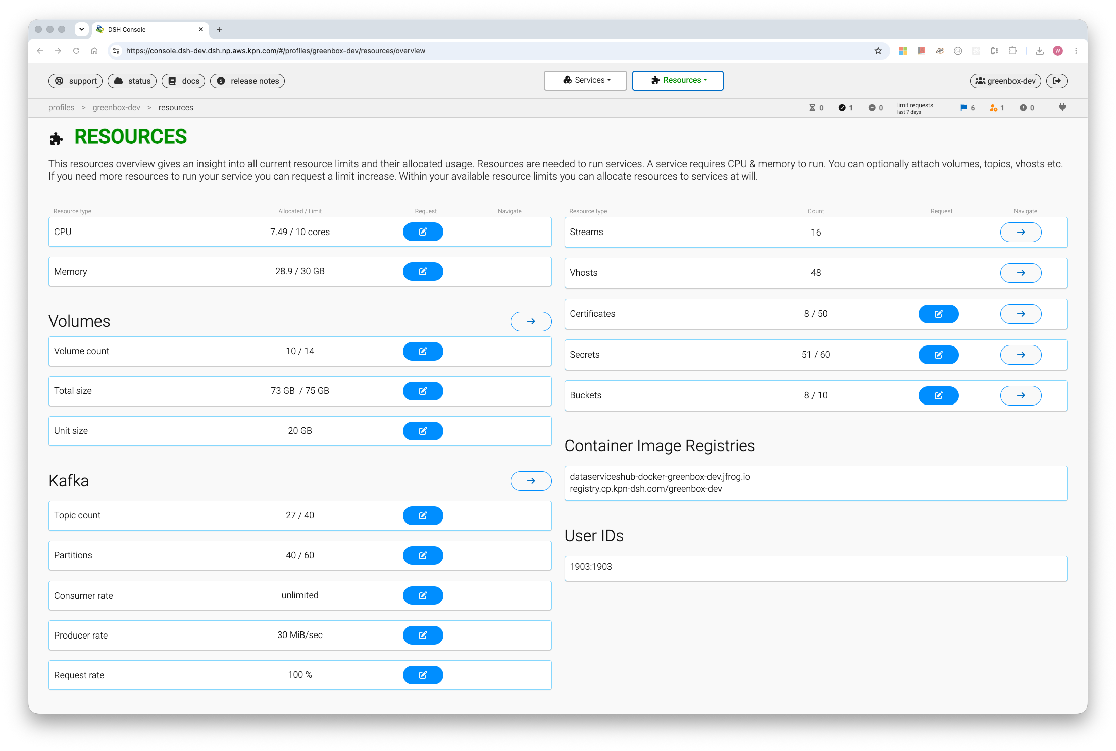
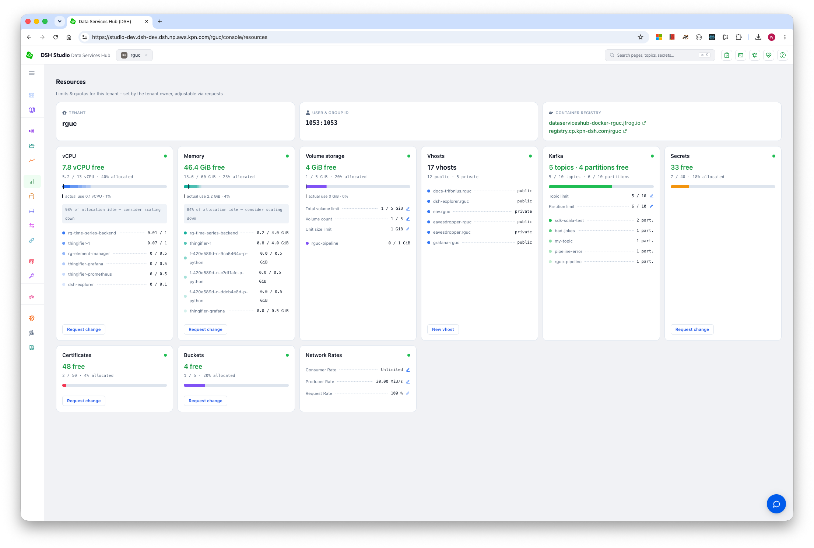
use cases
development
operations
ci/cd and scripting
users that prefer a cli over a web interface
alternatives: dsh console and dsh studio

Slide 4
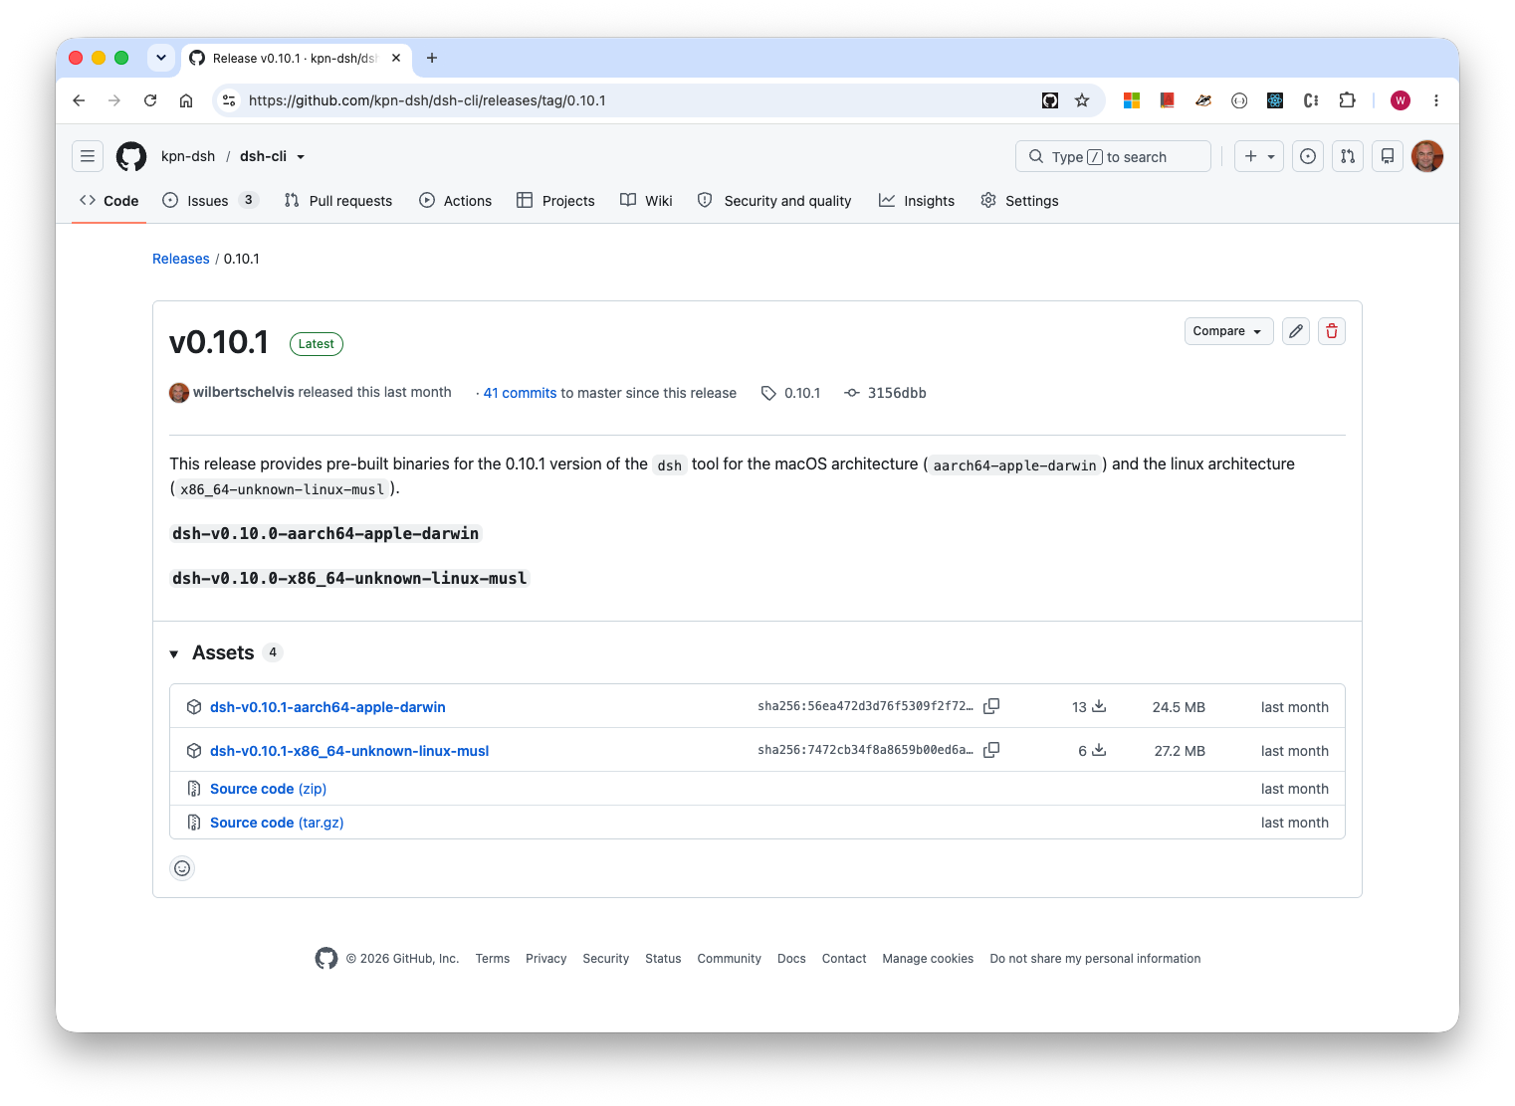
installation
download pre-built binary from github
    available for macos and linux
    github.com/kpn-dsh/dsh-cli/releases
clone from github and build it yourself
    requires rust toolchain
    requires access to artifactory.kpn.org
> git clone git@github.com:kpn-dsh/dsh-cli.git
> cd dsh-cli
> cargo build --release --locked
> ./target/release/dsh

Slide 5
capabilities (1)
aclgroups – manage acl groups, grant / revoke access to topics
api – directly call dsh api operations
app – view and manage apps
bucket – view and manage buckets
certificate – view and manage certificates
env - find values used in configurations
image - view image usage
login - login via single sign on
logout - logout from single sign on
manifest - view app catalog manifests
metric - view metric exports
nodepool – view nodepool resources
platform - view platform data and parameters

Slide 6
capabilities (2)
proxy – view, manage and certify kafka proxies
robot – view and manage robot passwords
secret – view and manage secrets
service – view and manage services
setting – view and manage tool settings
stream – view and manage managed streams
task - view service tasks
target – view and manage target configurations
tenant - view and manage managed tenants
token - fetch tokens
topic – view and manage scratch topics
vhost - view and certify vhosts
volume – view and manage volumes

Slide 7
help commands
all commands have help text
tool can generate autocomplete files
> dsh
> dsh -h
> dsh --help
> dsh secret
> dsh secret --help
> dsh secret create --help
> dsh --generate-autocomplete-file <SHELL>

Slide 8
single sign on
use when working interactive
authenticate via grip
actions are logged on user level
single sign on per platform
access to all authorized tenants
> dsh login
> dsh logout
> dsh --authentication single-sign-on
> export DSH_CLI_AUTHENTICATION=single-sign-on

Slide 9
robot password
use when working non-interactive (ci/cd or scripting)
actions are logged on platform/tenant level
robot password per platform / tenant
access to one single tenant
passwords can be stored in your computer’s keyring
> dsh --authentication robot
> export DSH_CLI_PASSWORD=[redacted]
> export DSH_CLI_PASSWORD_FILE=~/.password
> dsh [COMMAND] --password-file ~/.password
> dsh robot copy / import / list /set / unset / update

Slide 10
configuration
environment variables
settings command
command line options
> dsh --env-vars
> dsh --env-var DSH_CLI_DRY_RUN
> export DSH_CLI_DRY_RUN=true
> dsh settings
> dsh setting set dry-run
> dsh robot update nplz ajuc --dry-run

Slide 11
vhost
add signed certificate to vhosts for apps and services
signing of private vhosts (*.kpn.org) via rock api
> export DSH_CLI_PLATFORM=nplz
> export DSH_CLI_TENANT=greenbox-dev
> dsh manifests
> dsh manifest kpn/eavesdropper
> dsh app deploy kpn/eavesdropper 0.10.0 demodropper
> dsh app show demodropper
> dsh app open demodropper
> dsh vhosts
> dsh vhost show demodropper
> dsh vhost add demodropper

Slide 12
proxy – create bundle
contains all configuration parameters for a kafka proxy
contains all certificates (possibly signed) and keys for a kafka proxy
contains all configuration parameters needed to create example code
> export DSH_CLI_TENANT=rguc
> dsh proxy create my-proxy
> ls -al /Users/wilbert/.dsh_cli/targets/np-aws-lz-dsh/rguc/bundles/proxy/my-proxy
> cat /Users/wilbert/.dsh_cli/targets/np-aws-lz-dsh/rguc/bundles/proxy/my-proxy/bundle.toml
> dsh proxys --bundle

Slide 13
proxy - deploy
creates and deploys the required secrets containing the certificates and keys
creates and deploys the kafka proxy
> dsh proxy deploy my-proxy
> dsh proxys
> dsh proxy show my-proxy

Slide 14
proxy – generate example code
  javascript (with package.json)
  json configuration file
  python
  rust (with Cargo.toml)
  scala3 (with build.sbt)
> dsh proxy code my-proxy scala3
> cd my-proxy-example-scala3
> ls -al
> sbt "runMain org.kpn.dsh.proxy.my_proxy.ListTopics"

Slide 15
proxy - aclgroups
create aclgroups
grant the aclgroup read/write access rights to topics
> dsh topics
> dsh aclgroup create my-aclgroup --read-topic bad-jokes
> sbt "runMain org.kpn.dsh.proxy.my_proxy.ListTopics"
> sbt "runMain org.kpn.dsh.proxy.my_proxy.Consumer scratch.bad-jokes.rguc

Slide 16
certificates
detailed certificate information
show potential certificate issues
show potential certificate issues for all authorized tenants
list rock certificates
list rock domains
> dsh certificates
> dsh certificate show demodropper-cert
> dsh certificates --issues
> dsh certificates --issues --expiration 300
> dsh certificates --issues --all-tenants
> dsh certificates --rock
> dsh certificates --rock-domains

Slide 17
secrets
detailed secret information
show potential secret issues
show potential secret issues for all authorized tenants
> dsh secrets
> dsh secret show cmd-server-cert
> dsh secrets --issues
> dsh secrets --issues --expiration 300
> dsh secrets --issues --all-tenants

Slide 18
dsh tenant
> dsh tenant -h
Show and manage tenants on the DSH.
Usage: dsh tenant [OPTIONS] [COMMAND]
Commands:
create Create managed tenant
delete Delete managed tenant
grant Grant access rights
list List managed tenants
revoke Revoke access rights
show Show managed tenant configuration
update Update managed tenant limits

Slide 19
dsh stream
> dsh stream -h
Show, manage and list internal and public managed streams.
Usage: dsh stream [OPTIONS] [COMMAND]
Commands:
create Create stream
delete Delete managed stream
list List streams
show Show manages stream configuration

Slide 20
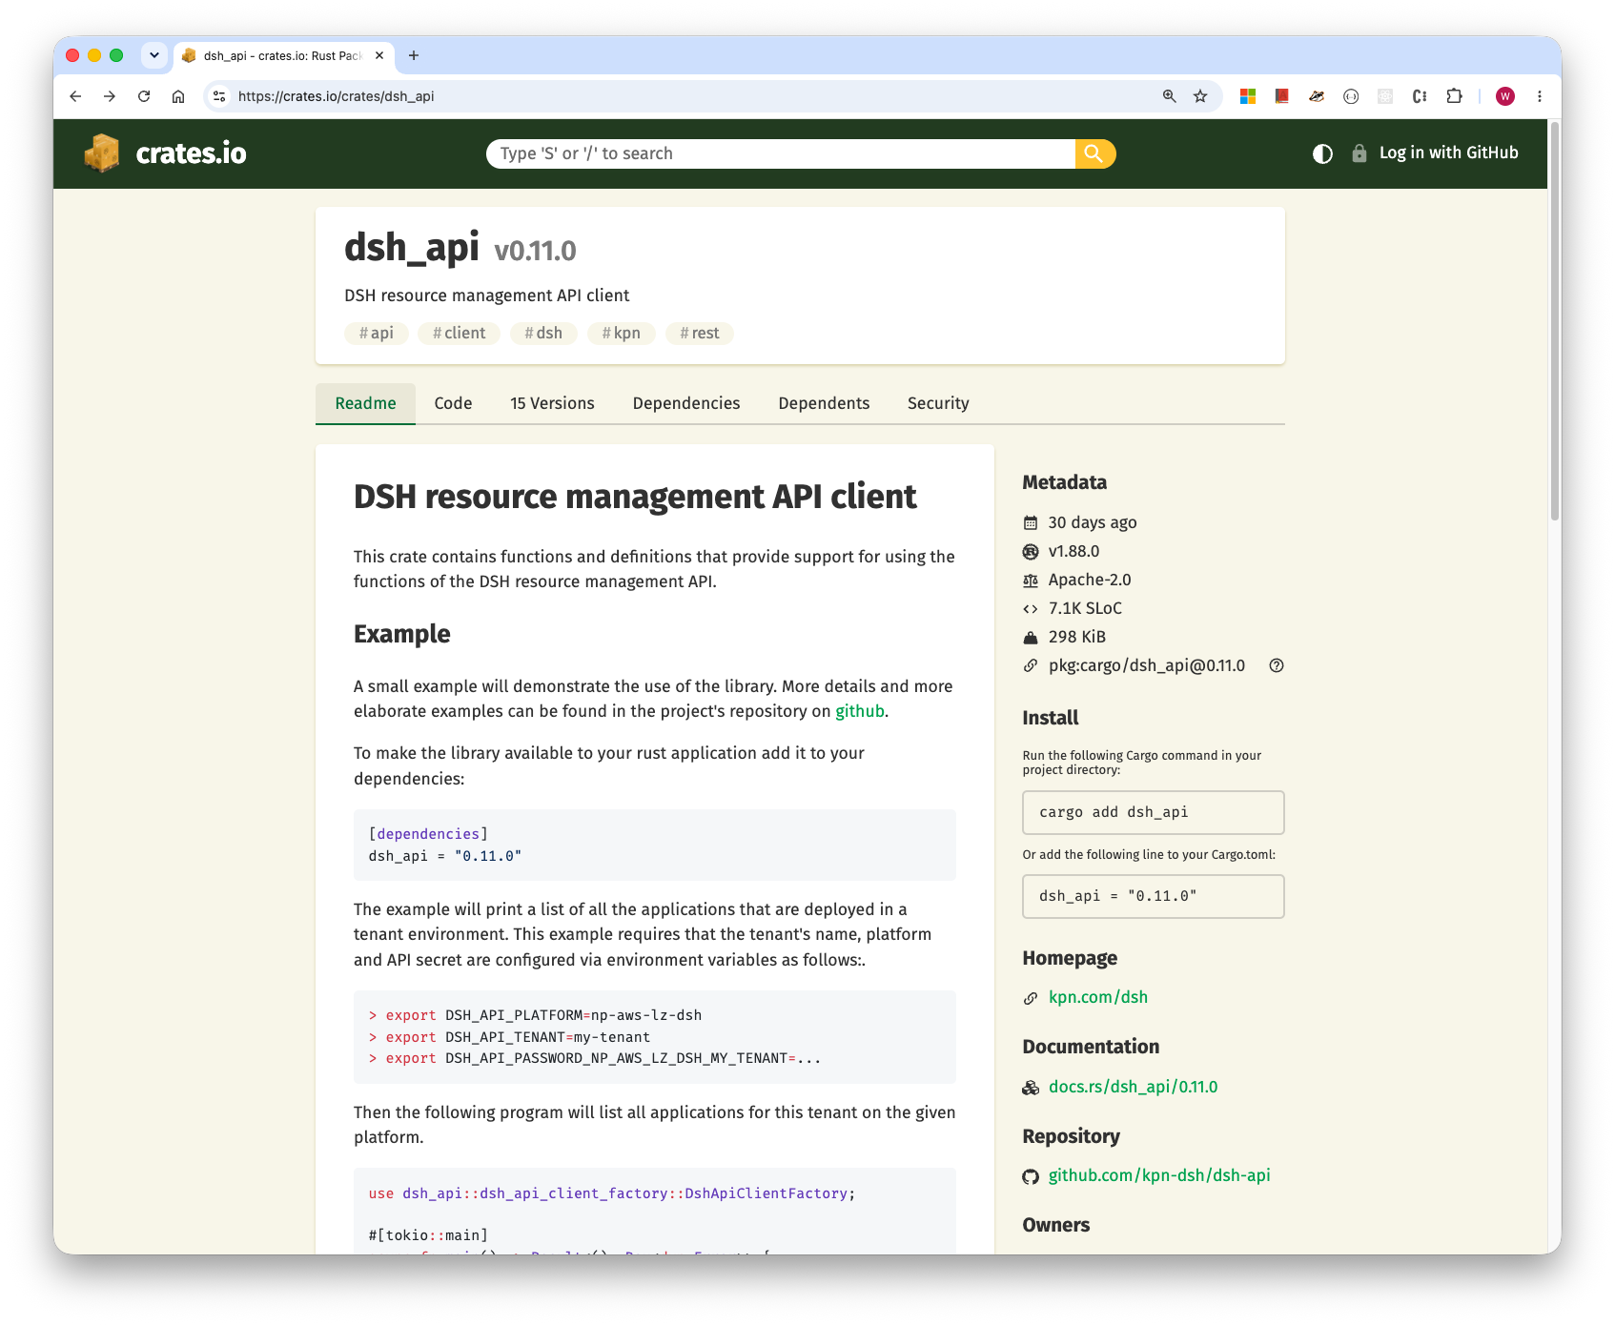
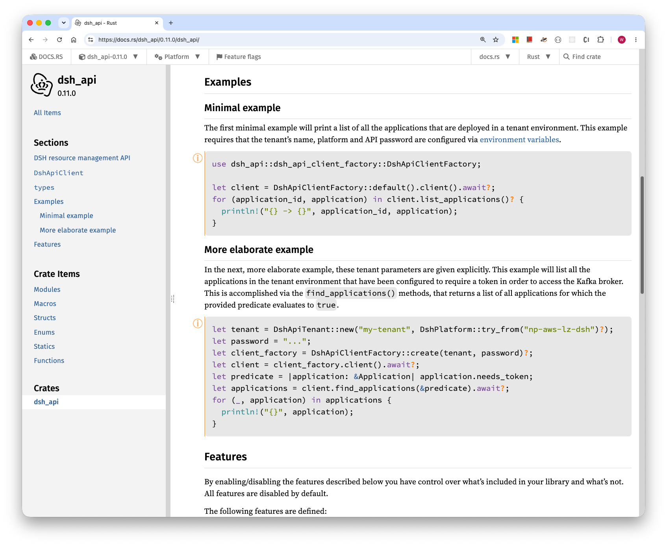
dsh-api – on crates.io and docs.rs

Slide 21
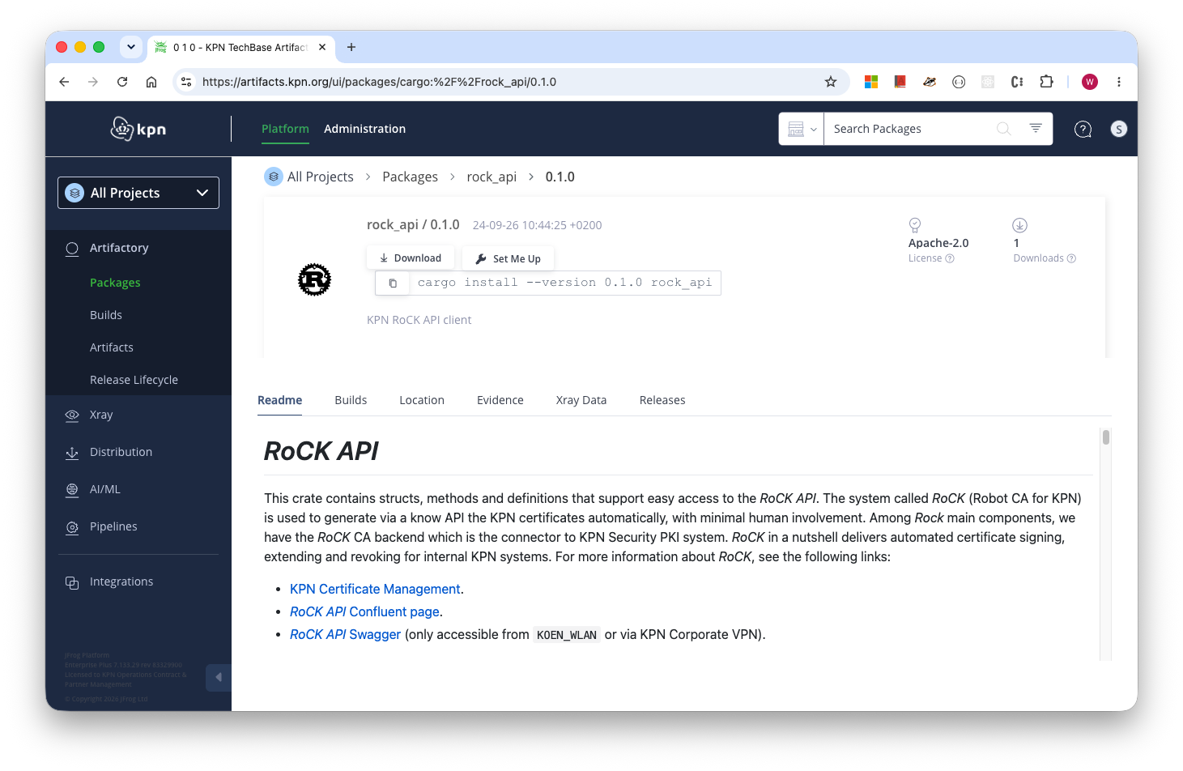
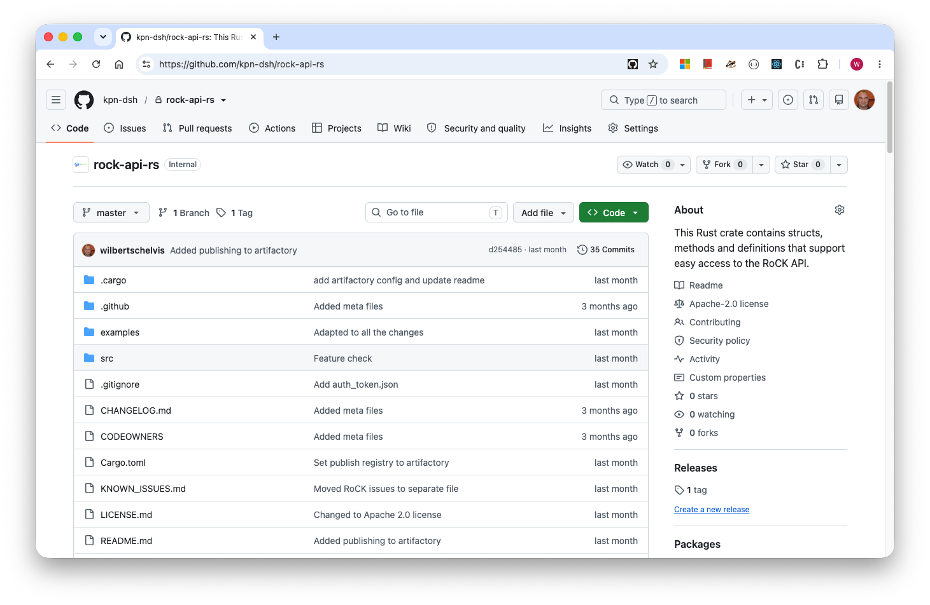
rock-api-rs – on artifactory and github

Slide 22
resources
dsh cli tool
    github repo (https://github.com/kpn-dsh/dsh-cli)
    quick-start (https://github.com/kpn-dsh/dsh-cli/blob/master/docs/quick-start.md)
    crates.io, until version 0.10.0 (https://crates.io/crates/dsh)
dsh api library
    github repo (https://github.com/kpn-dsh/dsh-api)
    rust dependency (https://crates.io/crates/dsh_api)
    documentation (https://docs.rs/dsh_api/0.11.0/dsh_api)
rock api library
    github repo (https://github.com/kpn-dsh/rock-api-rs)
    rust dependency and documentation (https://artifacts.kpn.org/ui/packages/cargo:%2F%2Frock_api)

Slide 23
rtfm

